Slide 1
Building a smart green system to control water leakage and monitor drinking water quality in the water supply system of Paramythia city, Greece: the case of SMASH project
Angelos Chasiotis
PhD student
Laboratory of Climatology and Atmospheric Environment
National and Kapodistrian University of Athens
Project: Smart green system for leakage control and water quality monitoring of water district area of city Paramythia of Municipality of Souli
*co-financed by Iceland, Liechtenstein, Norway European Economic Area (EEA) Grants 2014 – 2021 and Greek Public Investments Program

Slide 2
Authors
Angelos Chasiotis¹, Stavroula Tsitsifli², Konstantinos Panytsidis², Vegard Nilsen³,
Nikolaos Mantas², Dimitrios Theodorou², Thomas Kyriakidis², Stefanos Chasiotis¹, Maria Bousdeki¹,
Elissavet Feloni¹, Harsha Ratnaweera³, Panagiotis Nastos¹, and Malamati Louta²
¹Faculty of Geology and Geoenvironment - Laboratory of Climatology and Atmospheric Environment, National & Kapodistrian University of Athens, Athens, Greece A.Chasiotis@geol.uoa.gr
²Department of Electrical and Computer Engineering - Telecommunication Networks and Advanced Services (TELNAS) Laboratory, University of Western Macedonia, Kozani, Greece
³Department of Building and Environmental Technology - Faculty of Science and Technology, Norwegian University of Life Sciences, As, Norway
EGU23-10057
https://doi.org/10.5194/egusphere-egu23-10057
EGU General Assembly 2023
© Author(s) 2023

Slide 3
Project’s scope
Smart green system to control water leakage and monitor drinking water quality in the water supply system of Paramythia city (in northwest Greece).
(a) an Internet-of-things (IoT) system comprising three local control stations, installed in selected parts of the water supply network, monitoring water quantity and quality parameters in real time
(b) the hydraulic simulation model of the water supply system of Paramythia city closed network
(c) a virtual sensors system, which will be used for water quality prediction
(d) a Decision Support System (DSS) for leakage detection and optimal management of water supply system parameters in an automated manner

Slide 4
DSS
Decision Support System combined with on-line hydraulic model for leakage detection.
The DSS will detect and locate water leakages within the DMA zone and inform the operators for excessive values in drinking water quality parameters
The DSS will use as inputs the data from the IoT system, will interact with the hydraulic simulation model, and obtain the water quality data from the virtual sensors
All these data will be processed by the DSS logic in the backend subsystem
The IoT and the hydraulic simulation data, based on the digital twin of the water supply system, are used for the calculation of specific performance indicators (PIs) related to water leakage, such as well-known IWA indicators: water losses per Km of pipes or per connection, real losses per Km of pipes or per connection, ILI, etc

Slide 5
DSS
Decision Support System combined with on-line hydraulic model for leakage detection.
Calculating the divergences between the PI values observed and the ones representing the optimal operation of the water network without leakages and setting appropriate thresholds, the DSS will detect the leakage.
Several different scenarios will run in the hydraulic simulation model, scenarios results assessment will indicate the wider region of the leakage.
The frontend subsystem of the DSS will be able to visualize the water distribution network, statistical values of water quantitative and qualitative parameters and the PIs values.
The DSS will be able to provide alarms in cases of leakage or exceedance of water quality parameters’ values and it will show the leakage location in a map.

Slide 6
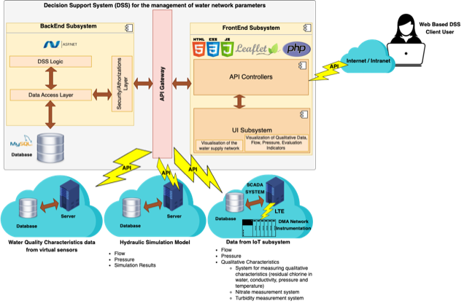
Smart Green System Architecture

Slide 7
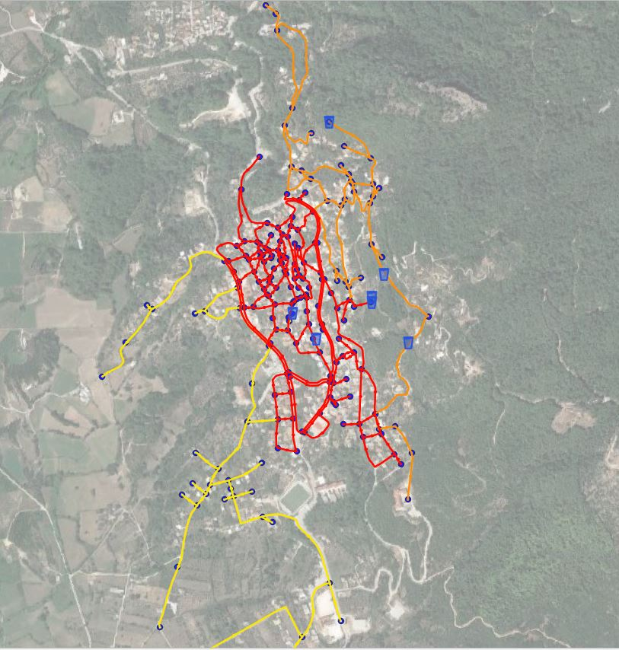
GIS on City

Slide 8
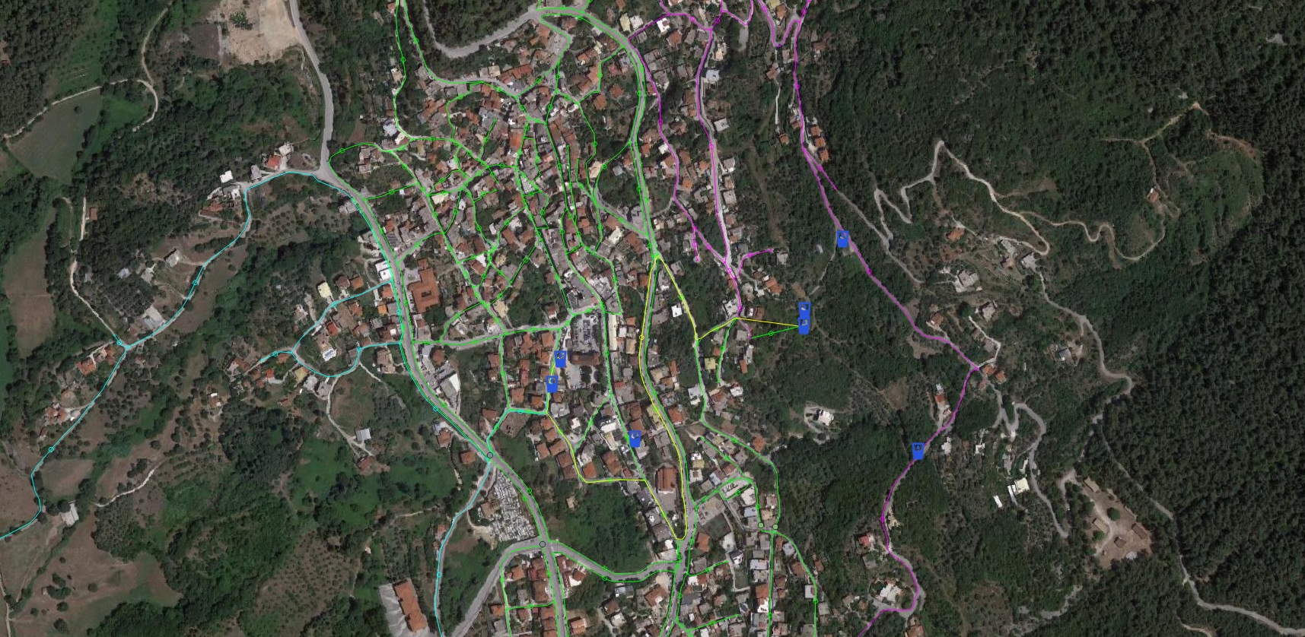
GIS on City

Slide 9
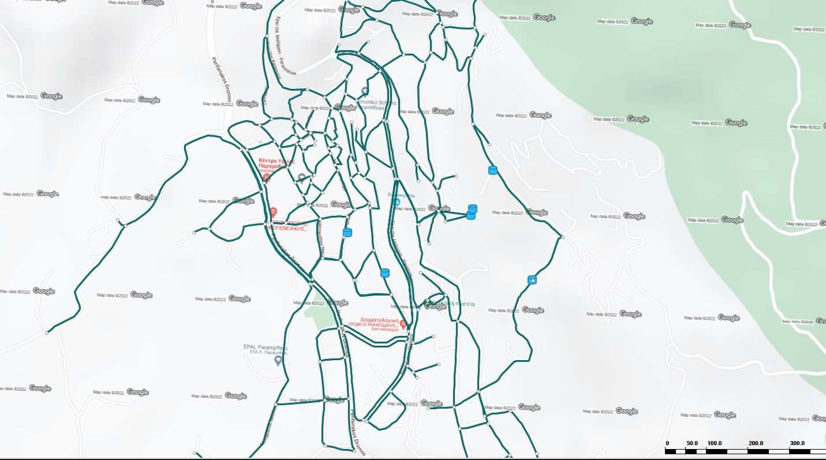
Network Map

Slide 10
Conclusion
Expected results on the implementation of the Smart Green System.
The upgrading of the existing water infrastructure of the Municipality of Souli
The convergence of the water balance of the closed zone of the Paramythia area
The control / reduction of water leakages and the improvement of the adequacy and quality of water
Beneficiaries of the Smart Green System are the residents and tourists of the Paramythia area of the Municipality of Souli (namely 3,032 inhabitants)
In conclusion the smart green system is expected to constitute a useful system to the water utility operation, introducing significant improvements.

Slide 11
Thank you for your attention!

